Slide 1

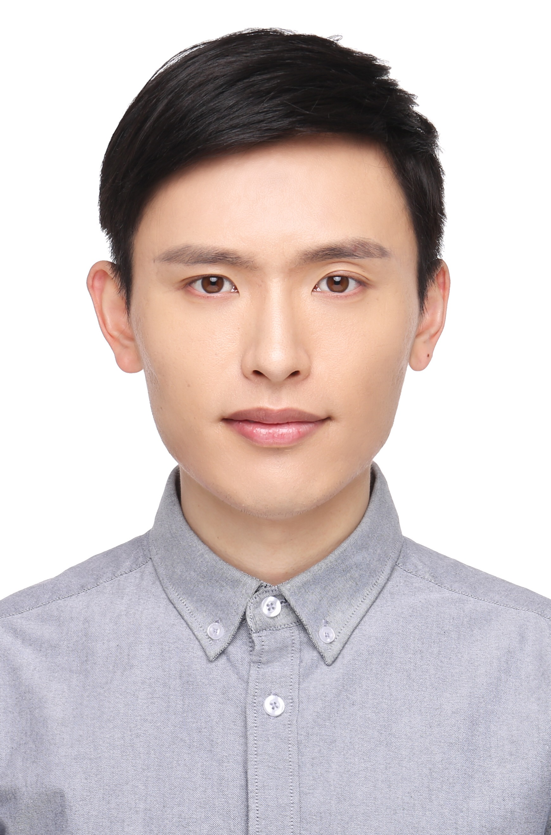

Goal-Driven Exploration for Android Applications
Duling Lai
Julia Rubin
The University of British Columbia, Vancouver, Canada
Nov 12, 2019
Notes:
Hello, my name is Duling Lai and I am going to present our paper – “Goal-Driven Exploration for Android Applications”. This is a joint work with Professor Julia Rubin from the University of British Columbia.

Slide 2
Motivation
GOAL
Check app permissions requested from Facebook
(e.g. friend list, user likes)
To get the list of permissions, Bob needs to explore the app driven by this goal:
01: LoginManager.getInstance().
02: logInWithReadPermissions(
03: fragmentOrActivity,
04: Arrays.asList("user_friends"));
Bob
API
Facebook login screen
Introduction
Our Approach
Evaluation
Notes:
And here is Bob. Bob is testing mobile apps and his goal is to check how apps handle Facebook permissions, such as getting the list of friends or user likes. In particular, Bob wants to check whether apps correctly handle the case where the user declines to grant some of the permissions an app requests and do not crash, for example. To do that, he needs to find and trigger the Facebook login function (SHOW) and monitor the API (SHOW) that reads the permission granted by Facebook.

Slide 3
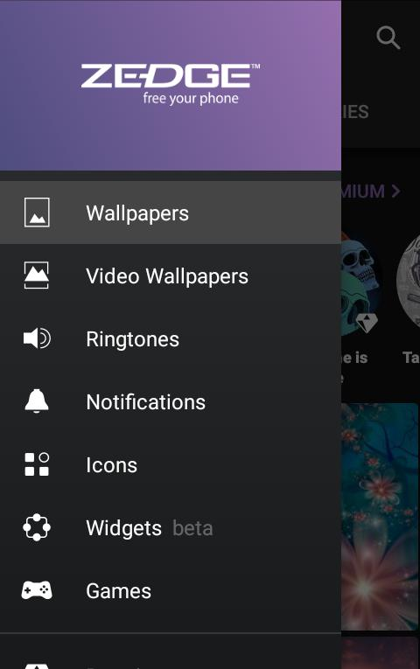
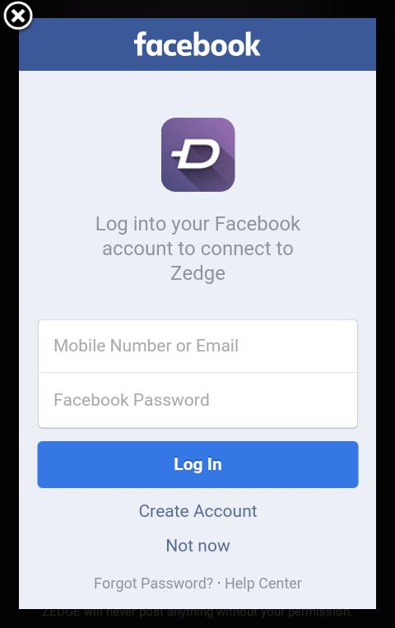

Triggering Facebook Login Is Not Easy
ZEDGE*
100M+ Downloads
Facebook Login
…
Personalization
(ringtones, wall papers etc.)
https://www.zedge.net/
*
Introduction
Our Approach
Evaluation
Notes:
It turns out that this is not a simple task. Let’s see an example.
This is Zedge, a very popular personalization app with over 100 million downloads on Google Play. It is so popular because it provides a large collection of ringtones and wallpapers. It also allows users to login with Facebook account so that users can save their favourite ringtones and wallpapers.

Slide 4
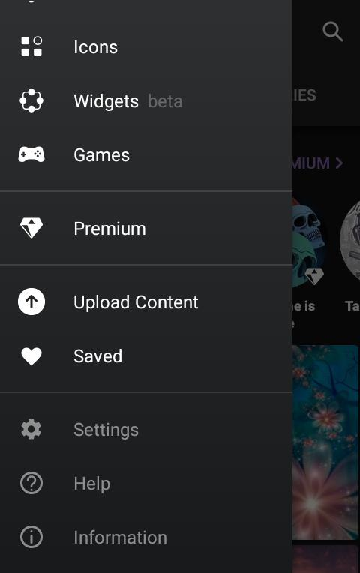
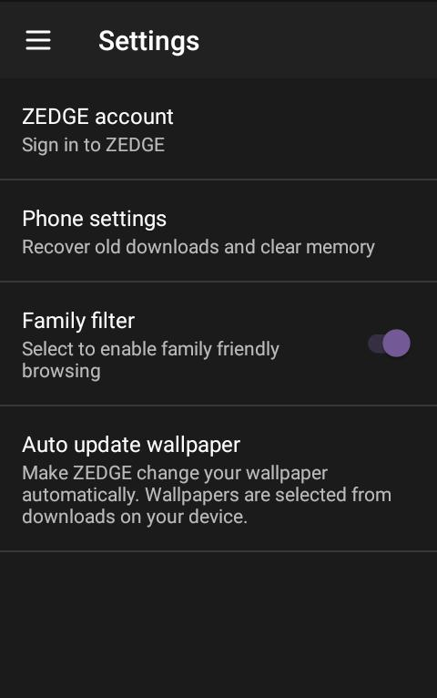


Triggering Facebook Login Is Not Easy
01
02
03
11th Item
Introduction
Our Approach
Evaluation
Notes:
First, Bob needs to scroll all the way down in the menu of all possible operations in the first screen to the 11th menu item, then click the “Settings” button in the second screen to open the “Settings" view, then click “ZEDGE account” in the third,

Slide 5
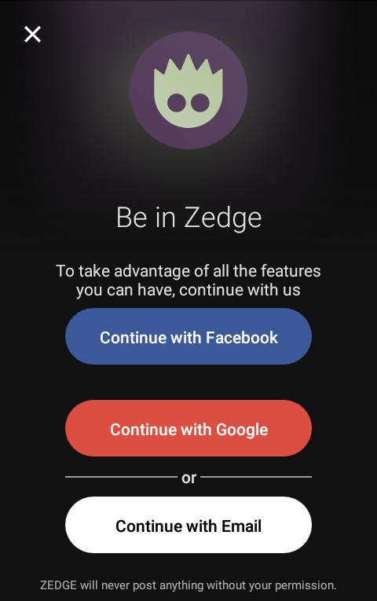
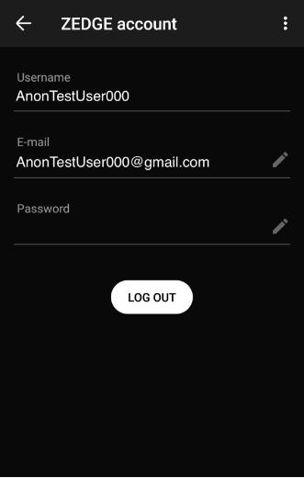
Triggering Facebook Login Is Not Easy
04
05
06
Introduction
Our Approach
Evaluation
Notes:
and only then click on “Continue with Facebook" in Screen 4, and enters his credentials in screen 5. After Bob logs into the app, his account info is displayed on Screen 6. We can see that it is a non-trivial process to navigate the app to the Facebook login, because at each screen, Bob has many options to choose from.
Now imagine that Bob is security analysis working for ???, and he needs to do that for 100s or 1000 apps.

Slide 6
Automated Testing Are Not Applicable
Automated Testing
Increase testing coverage
Find more bugs
Navigate directly to a particular target
E.g. Stoat^{[1]} and Sapienz^{[2]} cannot trigger Facebook login, exploring wallpapers and ringtones
…
[1] T. Su, G. Meng, Y. Chen, K. Wu, W. Yang, Y. Yao, G. Pu, Y. Liu, and Z. Su.
Guided, Stochastic Model-based GUI Testing of Android Apps. FSE’2017.
[2] K. Mao, M. Harman, and Y. Jia.
Sapienz: Multi-objective Automated Testing for Android Applications. ISSTA’2016.
Introduction
Our Approach
Evaluation
Notes:
Automated app exploration and testing tools are of limited help here because the goal of these tools is to explore as much of the app functionality as possible and detect bugs. They are not designed to promptly navigate to a particular functionality of interest and can easily get “stuck” exploring many possible feasible paths (SHOW), and miss the target (SHOW).
In fact, two state-of-the-art automated testing tools, Stoat and Sapienz, cannot trigger the Facebook login in ZEDGE after one hour of exploration, ending up exploring wallpapers and ringtones.

Slide 7
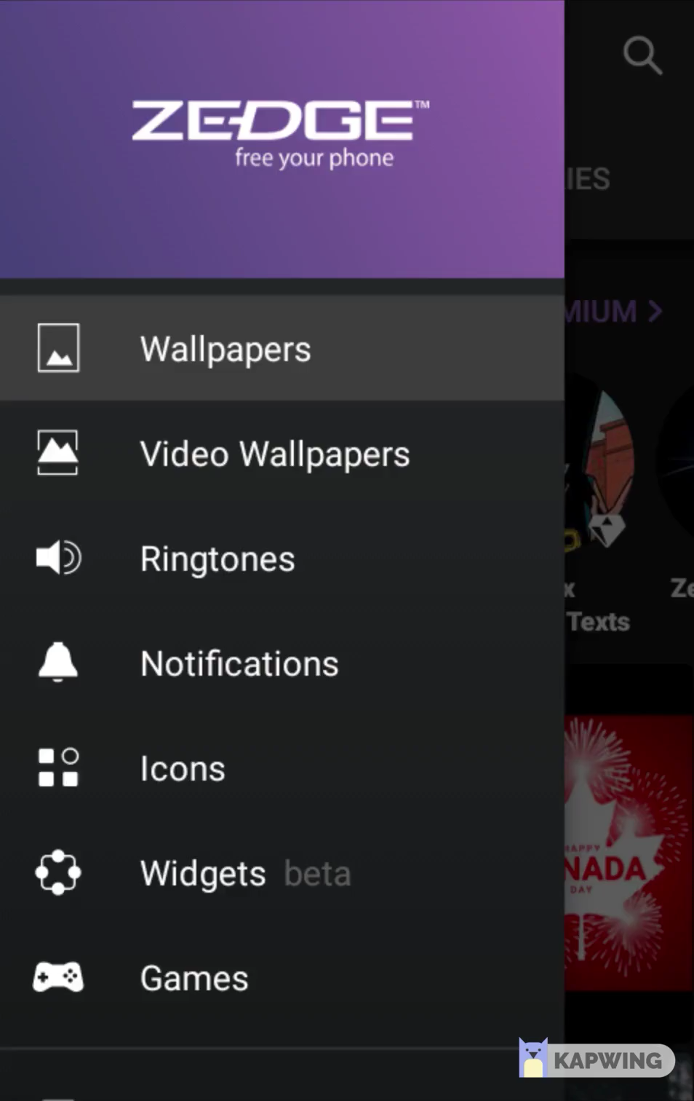
Our Goal
Goal-Driven Exploration
Develop a technique that automatically triggers the target functionality in an app
Introduction
Our Approach
Evaluation
Notes:
So, the goal of our work is to develop a technique that automatically triggers the target functionality in an app.

Slide 8

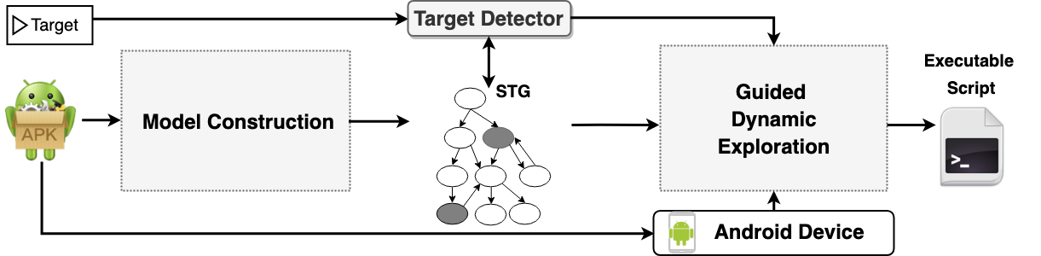
Our Solution
screens or program statements
Key Idea
Statically construct a UI model of the app
Mark the targets on the model
Use the model to guide dynamic exploration
Introduction
Our Approach
Evaluation
Notes:
A target can be a particular screen or a statement of code, as required for Bob’s scenario. We implement the idea of automatically navigating to the target in a tool called GoalExplorer. GoalExplorer first statically constructs a model of the app UI.
It then identifies the target in the model and dynamically navigates the app execution toward the target while consulting with the model. It also produces an executable script that can be repeatedly replayed to navigate to the target.

Slide 9
Model Requirement
Existing Approaches:
A³E^{[1]}
First proposed a model
Extends
Gator^{[2]}
Window Transition Graph
We need to model:
Service
Activity
Fragments
Screen the user sees
Activities
Fragments, drawers, menus, etc.
Broadcast Receiver
Drawer
Menu
Dialogs
Content Provider
Background components
╳
╳
Screen
Background
Components
[1] T. Azim and I. Neamtiu. Targeted and Depth-first Exploration for Systematic Testing of Android Apps. OOPSLA’2013
[2] S. Yang, H. Zhang, H. Wu, Y. Wang, D. Yan, and A. Rountev. Static Window Transition Graphs for Android. ASE’2015
Introduction
Our Approach
Evaluation
Notes:
The idea of building a static UI model of an app is not new by itself. A3E was the first to propose a model called activity transition graph; Gator later extends this model with window transition graph (WTG). However, both models only consider Android Activities and do not model UI screens correctly. That is because screens are a composition of multiple UI elements, such as fragments, which are modular sections of the screen placed on top of activities, drawers, menus etc.
In addition, the models do not contain background components, i.e. services, broadcast receivers, and content providers. Although these components are not directly responsible for the UI, the transitions between screens can happen via these background components.

Slide 10
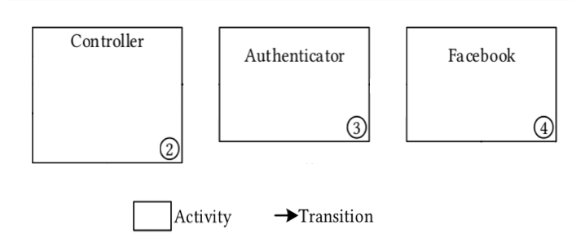
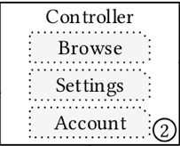
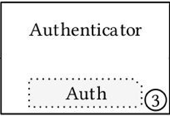
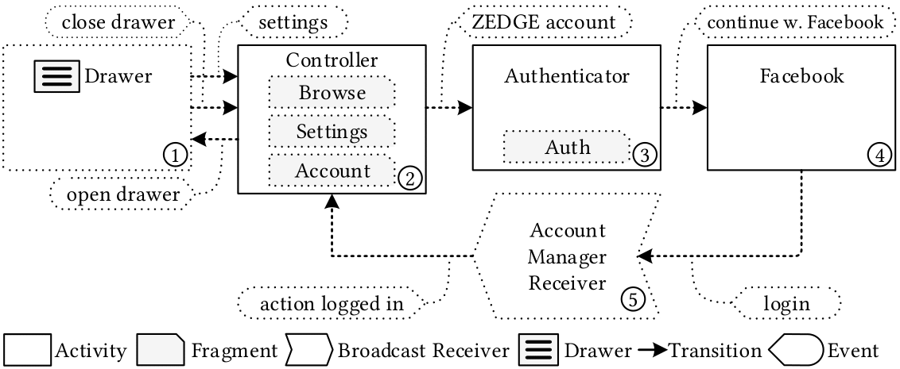
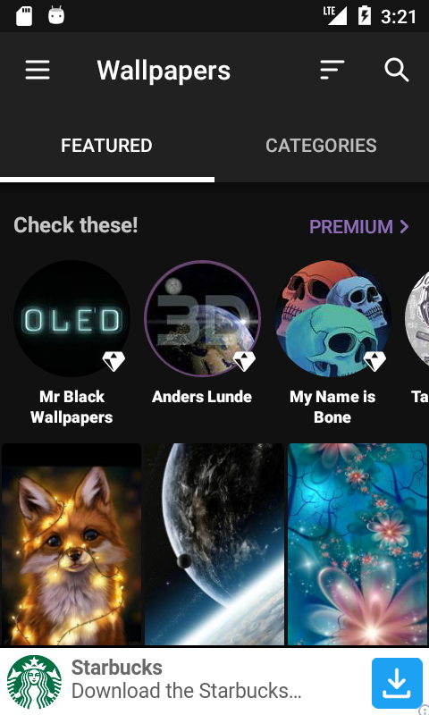
Direct Extension of WTG Does Not Work
Extending WTG by adding background components, fragments, drawers etc. (WTG-E)
Introduction
Our Approach
Evaluation

Slide 11
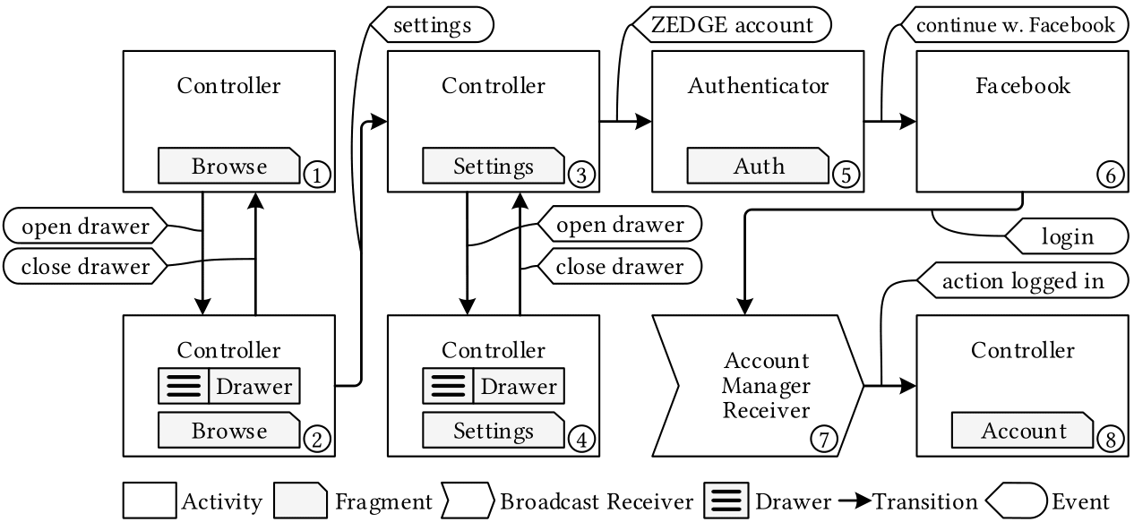
Our Model: Screen Transition Graph (STG)
Each node represents the actual screen that users sees
Introduction
Our Approach
Evaluation

Slide 12
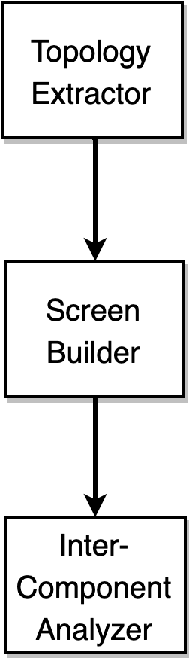
Building STG with Static Analysis
Collect App Components:
Activities
Services & broadcast receivers
Reconstruct Screens:
Creation/removal of fragments
Drawer/menu/dialog
Connect Components:
Transitions between different screens
Assign triggers
Introduction
Our Approach
Evaluation
Notes:
To build STG, we perform static analysis in three phases:
first, we decompose the APK and collect app components, i.e. activities, services, and broadcast receivers. We then reconstruct the screens by tracking the creation and removal of fragments in activities. We also analyze if the activities declare any menu, drawer, or dialog. We create a node for each screen the user sees.
Finally, we perform an inter-component analysis to find the right transitions between different screens in our model, assign the triggers to these transitions. For example, in our STG, clicking “ZEDGE account” button in the Node 3 would direct us to Node 5 (POINT).

Slide 13
Building STG Statically has Limitations
Over-approximations
Dynamic
Exploration
Under-approximations
Introduction
Our Approach
Evaluation
Notes:
More details about the model construction phase can be found in the paper. Unfortunately, static analysis we used to build the model is not perfect and suffers from inaccuracies, which makes it to both over-approximate and under-approximate the set of possible STG nodes and transitions. We discuss the reasons for these inaccuracies later on. Our tool attempts to resolve some of them during the dynamic exploration phase.

Slide 14
Dynamic Exploration
Finds the shortest path and follow the path
Interact with screen widgets if the intended transition is not enabled
If cannot move forward after a certain timeout: backtracks and finds an alternative path
Introduction
Our Approach
Evaluation
Notes:
The dynamic exploration starts with finding the shortest path to the target and following the path by performing actions on transitions.

Slide 15
Dynamic Exploration
Finds the shortest path and follow the path
Interact with screen widgets if the intended transition is not enabled
If cannot move forward after a certain timeout: backtracks and finds an alternative path
Introduction
Our Approach
Evaluation
Notes:
If it encounters a transition that it cannot trigger, it interacts with the widgets on the screen until the intended transition is available or it has passed a pre-set timeout.

Slide 16
Dynamic Exploration
Finds the shortest path and follow the path
Interact with screen widgets if the intended transition is not enabled
If cannot move forward after a certain timeout: backtracks and finds an alternative path
Introduction
Our Approach
Evaluation
Notes:
If the transition is still not possible, we assume that is a result of the over-approximation made by our static analysis, backtrack, and try to find an alternative path to the target.

Slide 17
Evaluation
We compare
With static UI model
(plugged into GoalExplorer’s dynamic explorer)
WTG-E
Direct extension of WTG to handle fragments, drawers, and background components.
With automated exploration tools
Sapienz^{[1]}
Record times when they reach each new target
Stoat^{[2]}
Stop execution if no new target reach for 1 hour
[1] T. Su, G. Meng, Y. Chen, K. Wu, W. Yang, Y. Yao, G. Pu, Y. Liu, and Z. Su. Guided, Stochastic Model-based GUI Testing of Android Apps. FSE’2017.
[2] K. Mao, M. Harman, and Y. Jia. Sapienz: Multi-objective Automated Testing for Android Applications. ISSTA’2016.
Introduction
Our Approach
Evaluation
Notes:
We evaluate the quality of the static and dynamic analysis performed by GoalExplorer by performing two lines of comparison. Our goal is to evaluate the ability of GoalExplore to reach a target and time it takes to do so.
First, we compare GoalExplorer with WTG-E -- a direct extension of WTG, which includes fragments, drawers, etc., as I mentioned earlier. WTG-E model is plugged into GoalExplorer’s dynamic explorer, so we can fairly compare our STG model against the existing static UI models. In a second line of comparison, we compare GoalExplorer with automated app exploration tools, Sapienz and Stoat. Since we cannot set the targets for these tools, we run them on each app and record times when the tools reach each new target. We stop the execution and record the fraction of targets reached once a tool does not discover any new targets for the period of one hour. We move to a new app then.

Slide 18
Evaluation
Targets
All activities of an app
To help Bob
1
2
All URL.openConnection statements
Subjects
93 open-source apps from Stoat
(benchmark apps)
Top 100 Google Play apps
Introduction
Our Approach
Evaluation
Notes:
For our evaluation, we used 93 open-source apps from the Stoat paper, which has become a standard benchmark for app exploration.
In addition, we downloaded the top 100 apps from Google Play, to further demonstrate the applicability and practical value of our approach.
We use two different sets of targets for these apps: activities and URL.openConnection statements. Both are motivated by Bob’s use case.

Slide 19

RQ1 & RQ2
Time
Coverage
WTG-E
Dynamic Tools
Compare with:
WTG-E
(% increase in coverage)
Automated Exploration Tools
(% less time to trigger targets)
 | Benchmark | Google Play
Activity | 14.1% | 10.3%
Statement | 34.2% | 26.9%
 | Benchmark | Google Play
Time to target activity | 97% | 96%
Time to target Statement | 96% | 93%
Introduction
Our Approach
Evaluation

Slide 20
RQ3 & RQ4
36 open-source apps that are also in Google Play
Collect all reachable URL.openConnection statements
FN (transitions absent in STG)
0.22
1
Inaccuracy of static analysis
Inaccuracy of the underlying tools
Dynamically-loaded contents
FP (STG transitions do not exist)
1.17
Assume any order of callbacks
Ignore fragment properties
2
2
Issues in triggering targets
Transitions that cannot be triggered
1.08
Require meaningful inputs
Require particular order of callbacks
Require certain server responses
reached 86 out of 102 targets, slightly more than Sapienz (74) and Stoat (80)
Good news
Introduction
Our Approach
Evaluation

Slide 21
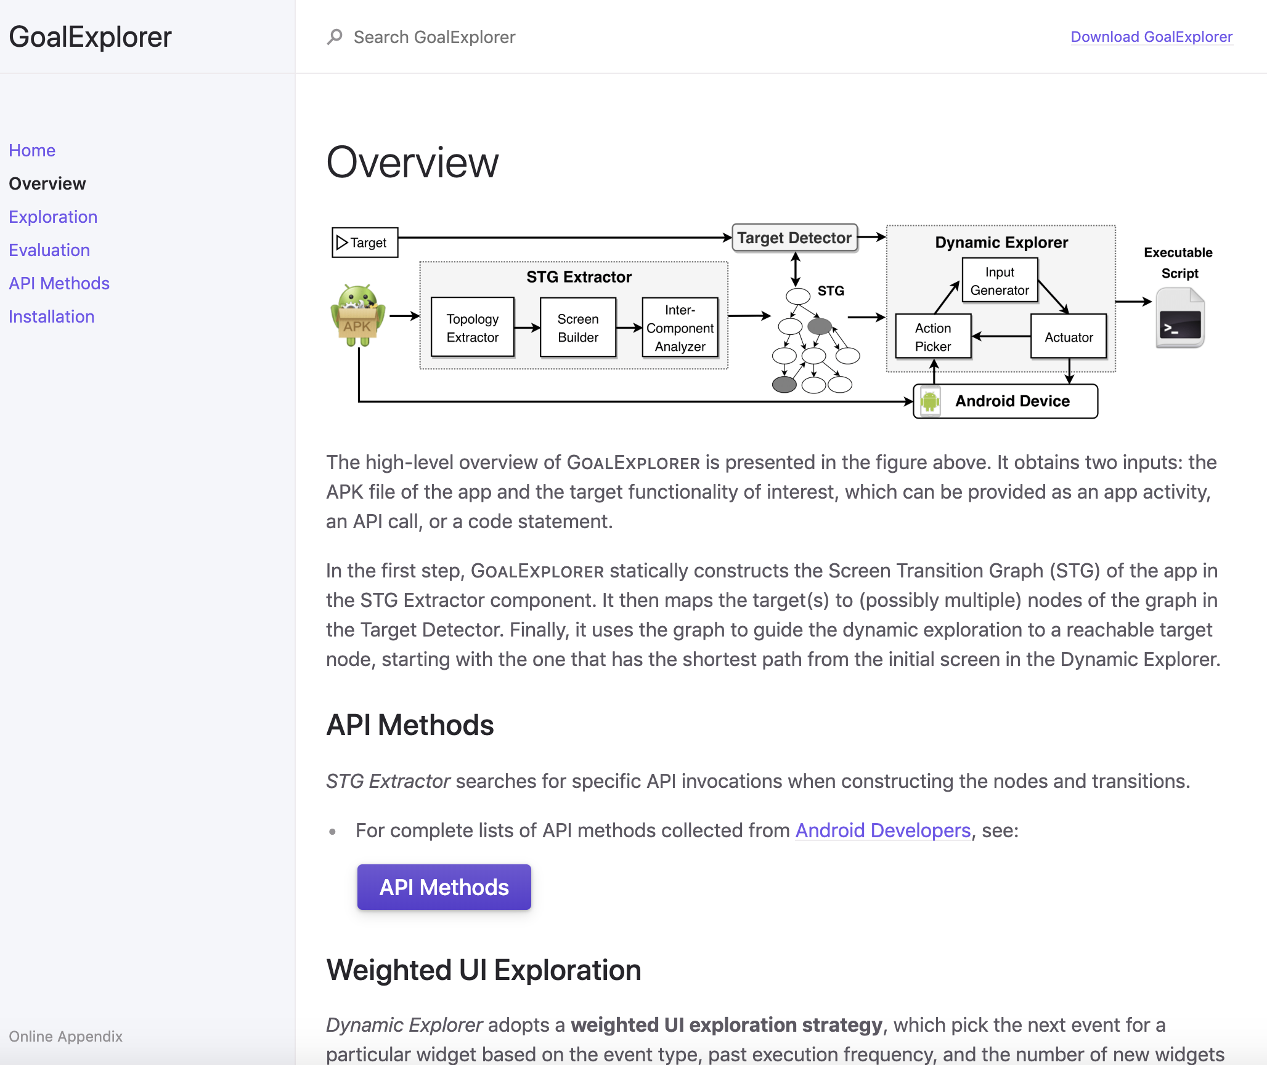
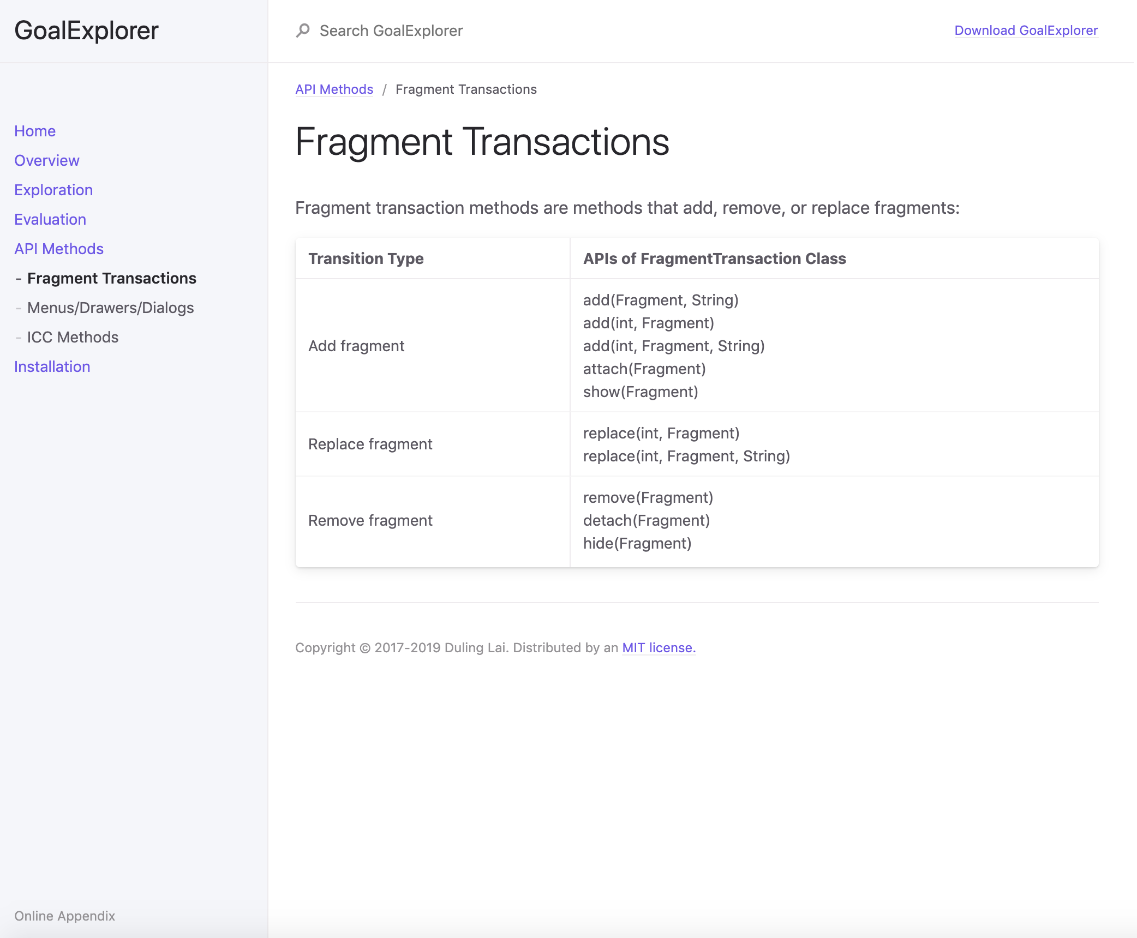
More Info
Implementation & Experimental Data: https://resess.github.io/PaperAppendices/GoalExplorer/

Slide 22
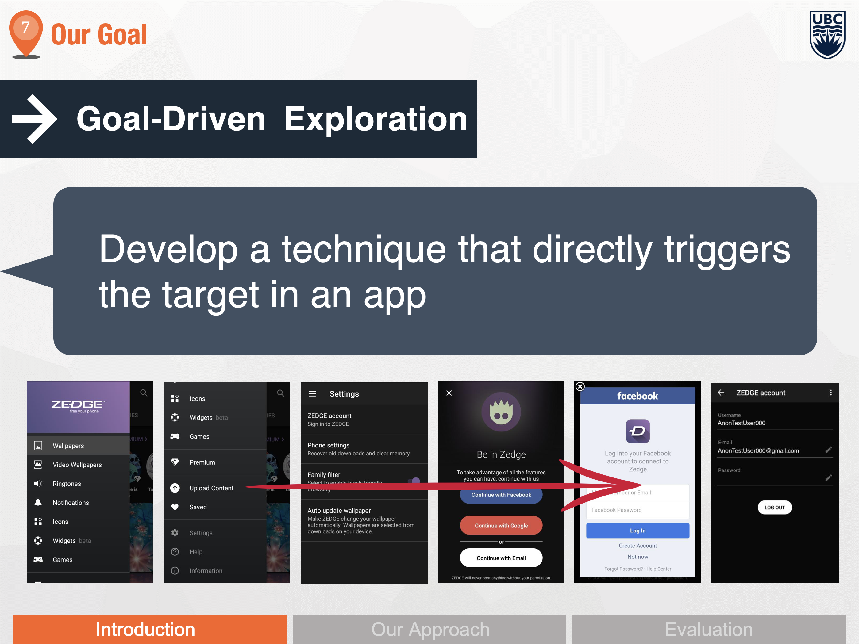
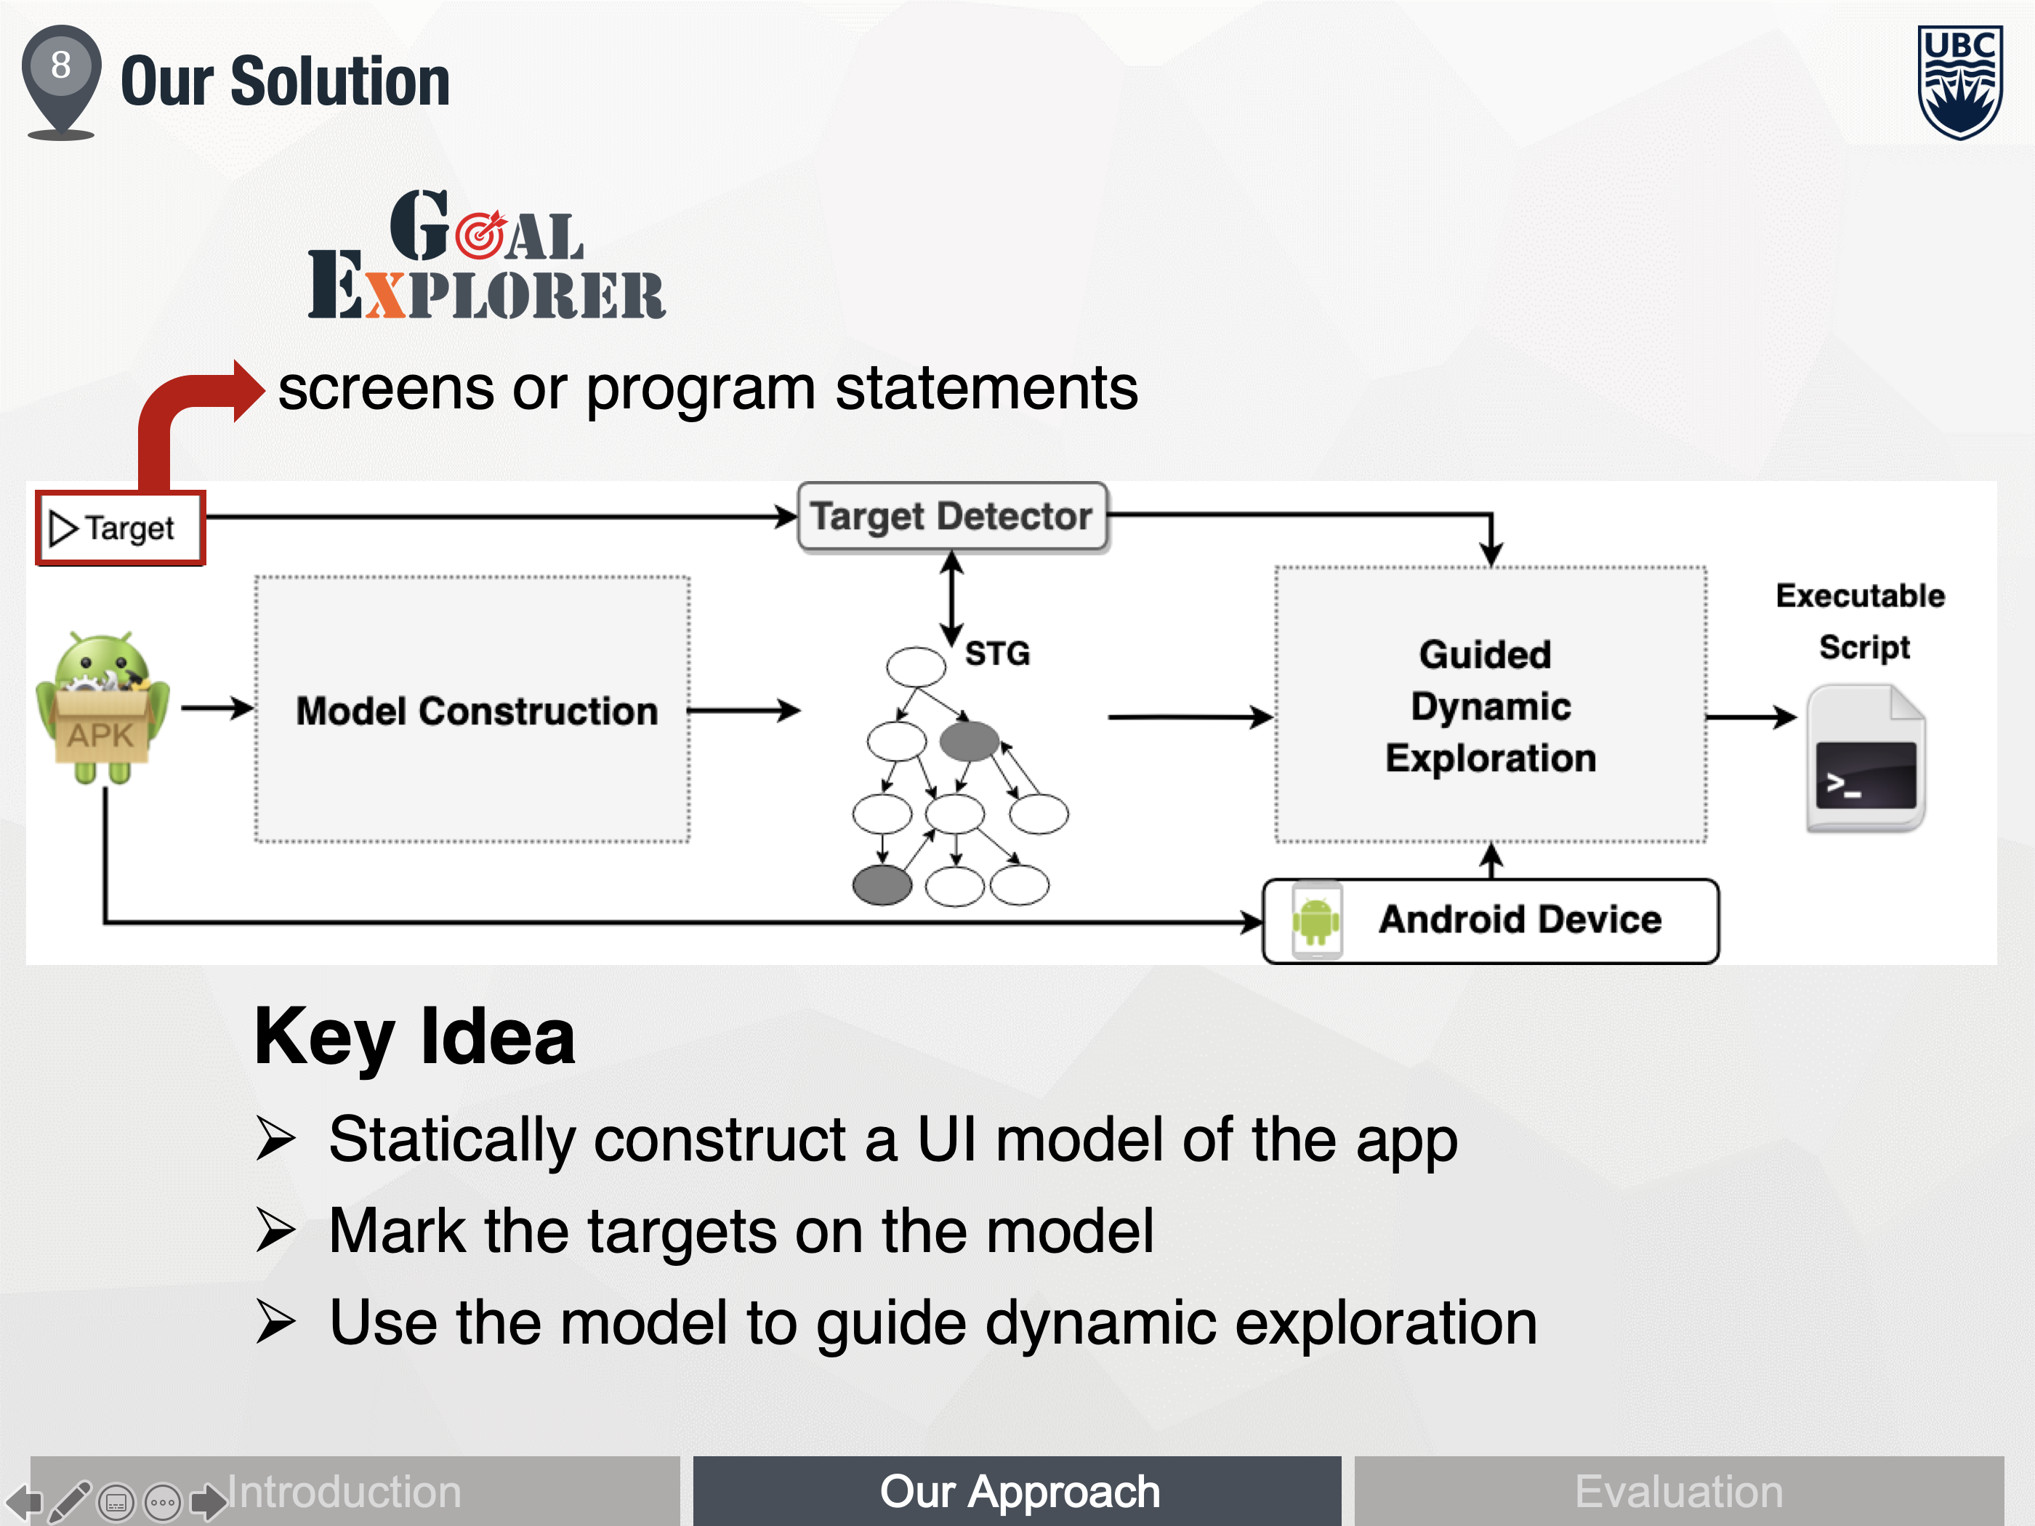
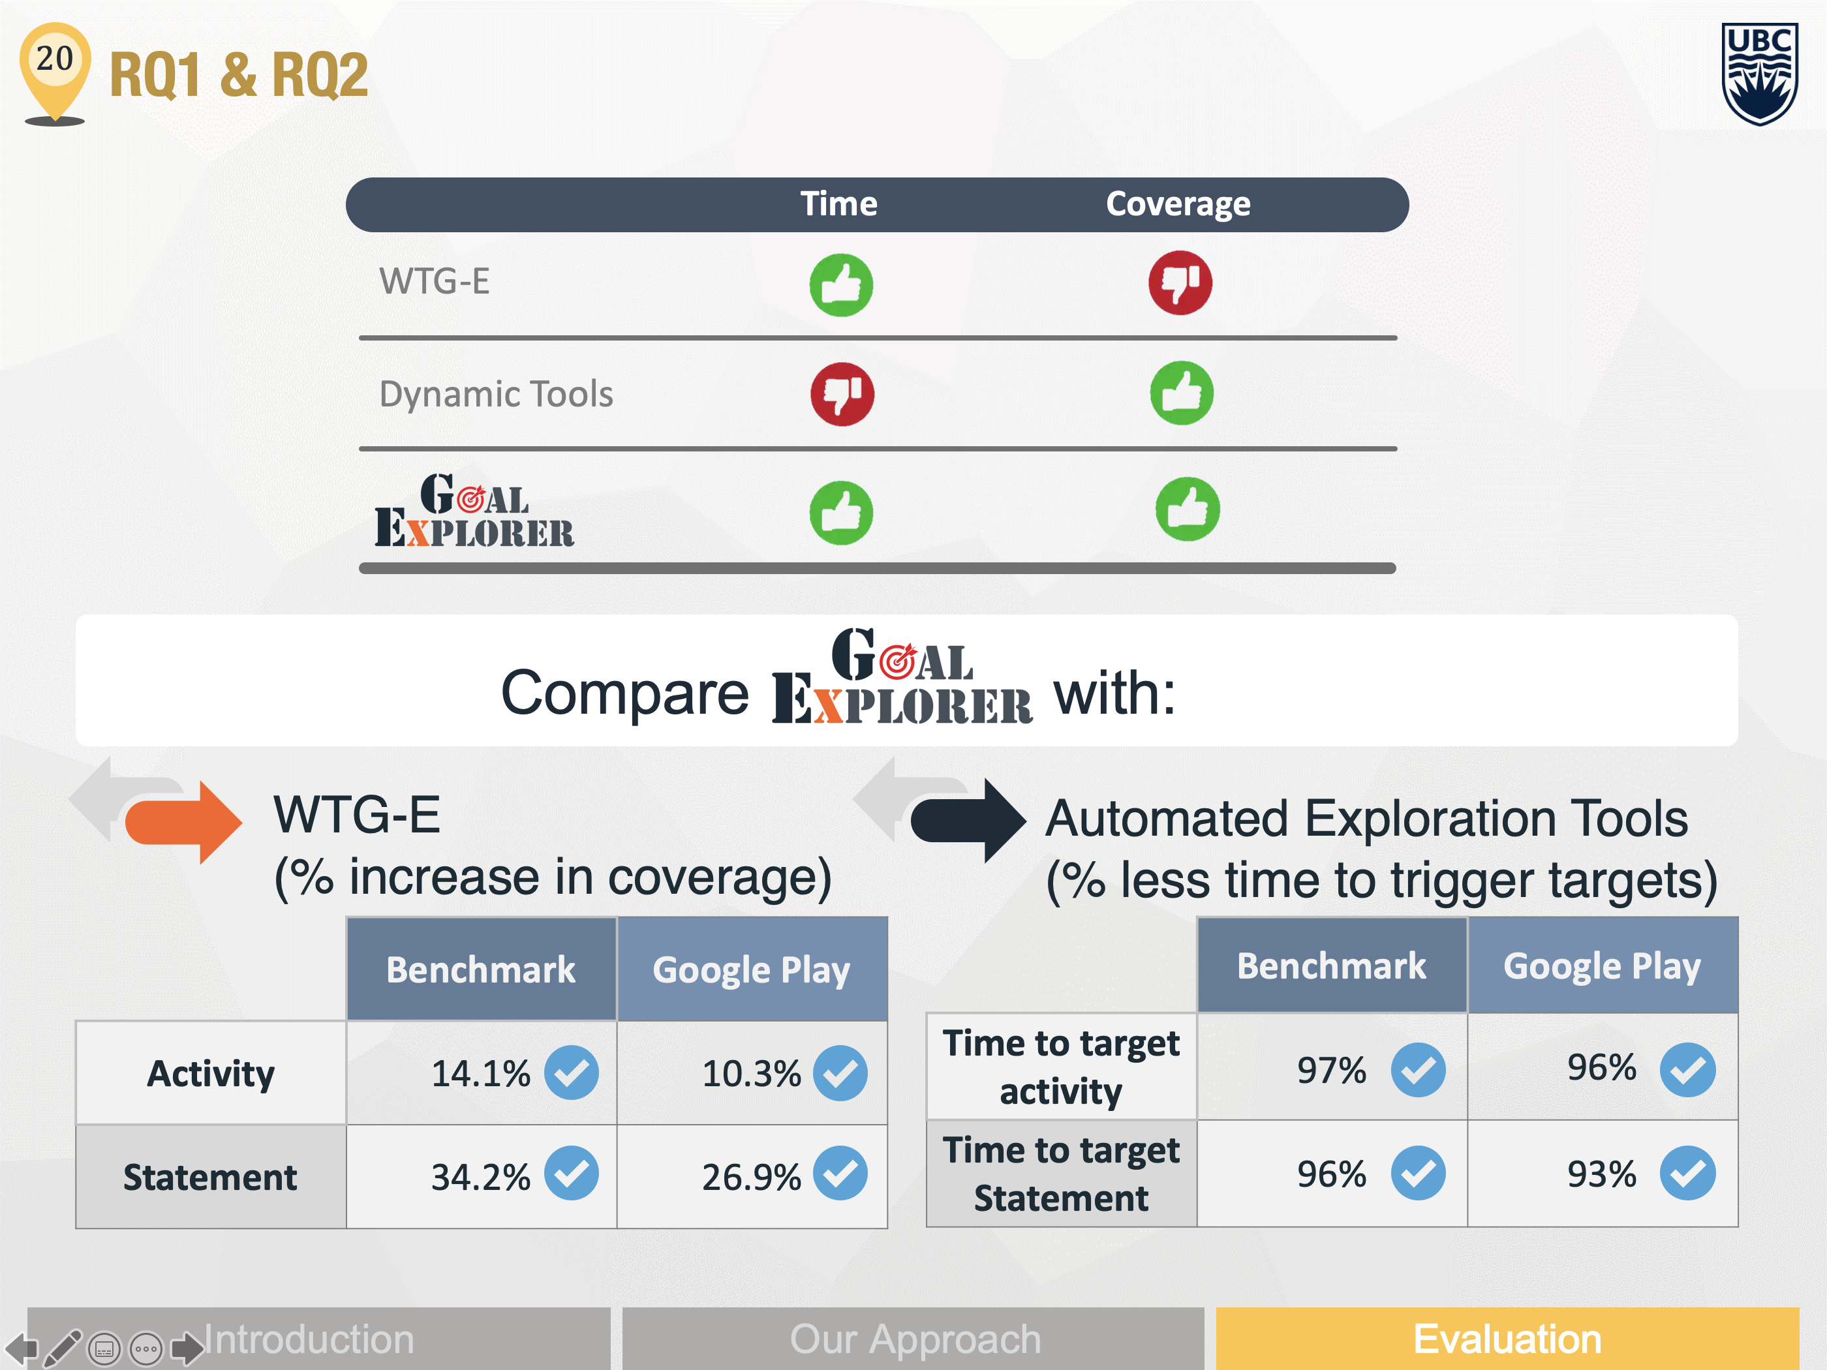
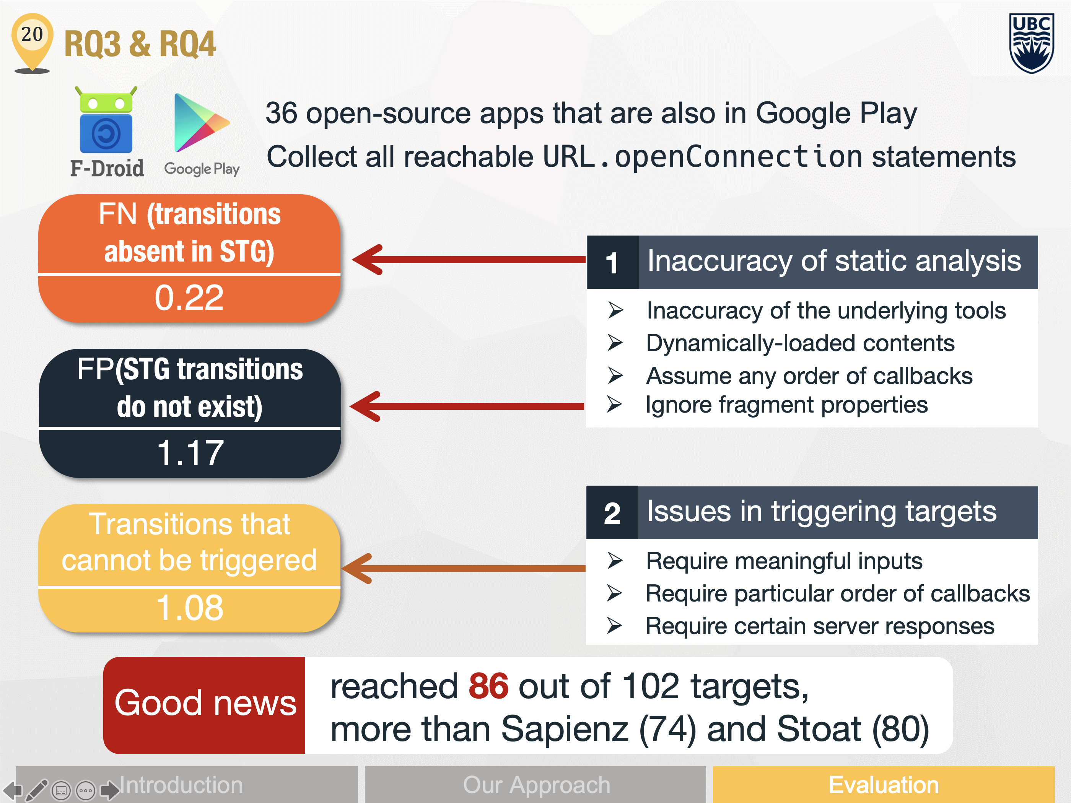
Conclusion
Duling Lai: laiduling@gmail.com Julia Rubin: mjulia@ece.ubc.ca

